Slide 1
Ivo Lašek
@ilasek
2018 Apache Spark Introduction

Slide 2
What is Spark good for?

Slide 3
Massive parallel processing
https://www.zdnet.com/article/google-opens-data-center-kimono-why-cloud-players-will-follow/

Slide 4
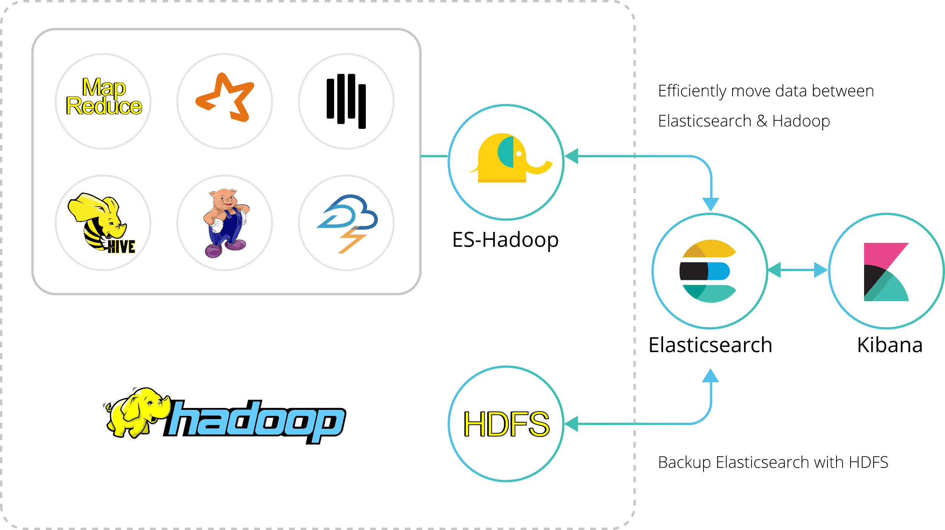
Large ETL jobs

Slide 5
Large ETL jobs
Machine learning – combinatorial explosion

Slide 6
Large ETL jobs
Unstructured data processing
Machine learning – combinatorial explosion
2.9 bilion base pairs
~ 700MB
Reality 200GB from a sequencer

Slide 7
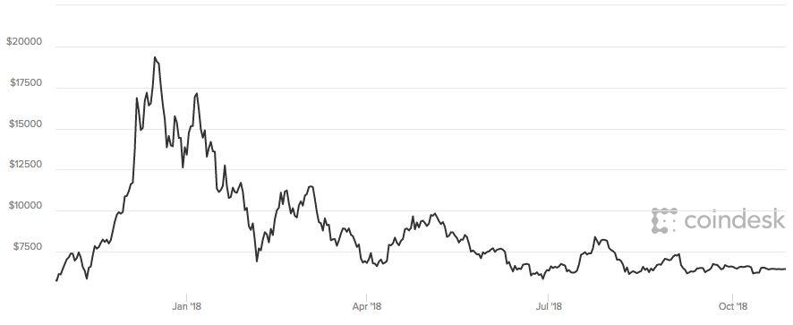
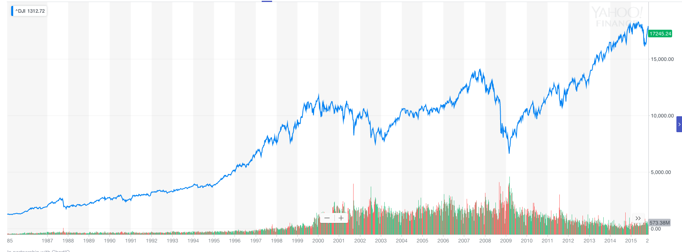
Large ETL jobs
Unstructured data processing
Machine learning – combinatorial explosion
Real time processing

Slide 8
How to process a large datasets?

Slide 9
Mapreduce, Inverted Index and wordcount
Page 1
cat dog cow
airplane -> page2, page6
cat -> page1, page3, page5
car -> page6
cow -> page1, page6
dog -> page1
Page 1
cat dog cow
airplane -> 2
cat -> 3
car -> 1
cow -> 2
dog -> 1

Slide 10
https://www.oreilly.com/library/view/distributed-computing-in/9781787126992/5fef6ce5-20d7-4d7c-93eb-7e669d48c2b4.xhtml

Slide 11
https://www.oreilly.com/library/view/distributed-computing-in/9781787126992/5fef6ce5-20d7-4d7c-93eb-7e669d48c2b4.xhtml

Slide 12
https://www.oreilly.com/library/view/distributed-computing-in/9781787126992/5fef6ce5-20d7-4d7c-93eb-7e669d48c2b4.xhtml

Slide 13
https://www.oreilly.com/library/view/distributed-computing-in/9781787126992/5fef6ce5-20d7-4d7c-93eb-7e669d48c2b4.xhtml

Slide 14
I/O
I/O
I/O
I/O
I/O
I/O
I/O
I/O
I/O
I/O
I/O
I/O
I/O
I/O
Network
https://www.oreilly.com/library/view/distributed-computing-in/9781787126992/5fef6ce5-20d7-4d7c-93eb-7e669d48c2b4.xhtml

Slide 15
RDD – Resilient Distributed Dataset

Slide 16
Dataset
Partition3
Driver
Partition2
Partition1
Executor1
Executor2
Executor3

Slide 17
val RDDa = spark.textFile("file.txt")
Partition3
Driver
Partition2
Partition1
Executor1
Executor2
Executor3
Distributed
RDDa
Partition1a
Partition2a
Partition3a

Slide 18
val RDDa = spark.textFile("file.txt")
RDDb = RDDa.flatMap(line => line.split(" "))
Partition3
Driver
Partition2
Partition1
Executor1
Executor2
Executor3
Immutable
RDDa
Partition1a
Partition2a
Partition3a
RDDb
Partition1b
Partition2b
Partition3b

Slide 19
val RDDa = spark.textFile("file.txt")
Partition3
Driver
Partition2
Partition1
Executor1
Executor2
Executor3
RDDa
Partition1a
Partition2a
Partition3a
Resilient

Slide 20
DAG – Directed Acyclic Graph

Slide 22
RDD
Transformation
Action

Slide 23
.filter(…)
.join(…)
.count()
.map(…)
textFileRDD.flatMap(…)
.filter(…)
textFileRDD
textFileRDD.filter(…)
RDD
.collect()
Transformation
Action

Slide 24
RDDs, DataFrames, Datasets

Slide 25
https://stackoverflow.com/questions/31508083/difference-between-dataframe-in-spark-2-0-i-e-datasetrow-and-rdd-in-spark

Slide 26
https://databricks.com/blog/2016/07/14/a-tale-of-three-apache-spark-apis-rdds-dataframes-and-datasets.html

Slide 27
Spark Ecosystem

Slide 28
Applications
(DataScience Notebooks, JDBC, …)
Spark SQL
Spark Streaming
MLLib
Graph
Spark Core
Scala
Java
Python
R
Yarn/Mesos

Slide 29
Ivo Lašek
@ilasek
2018 Apache Spark Intorduction

